Slide 1

Data Analysis and Visualization in R By: Sakshi Kakde

Slide 2
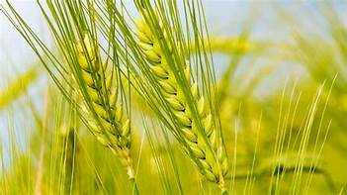
Dataset Name : Agriculture Crop Production In India
-Kaggle

Slide 3
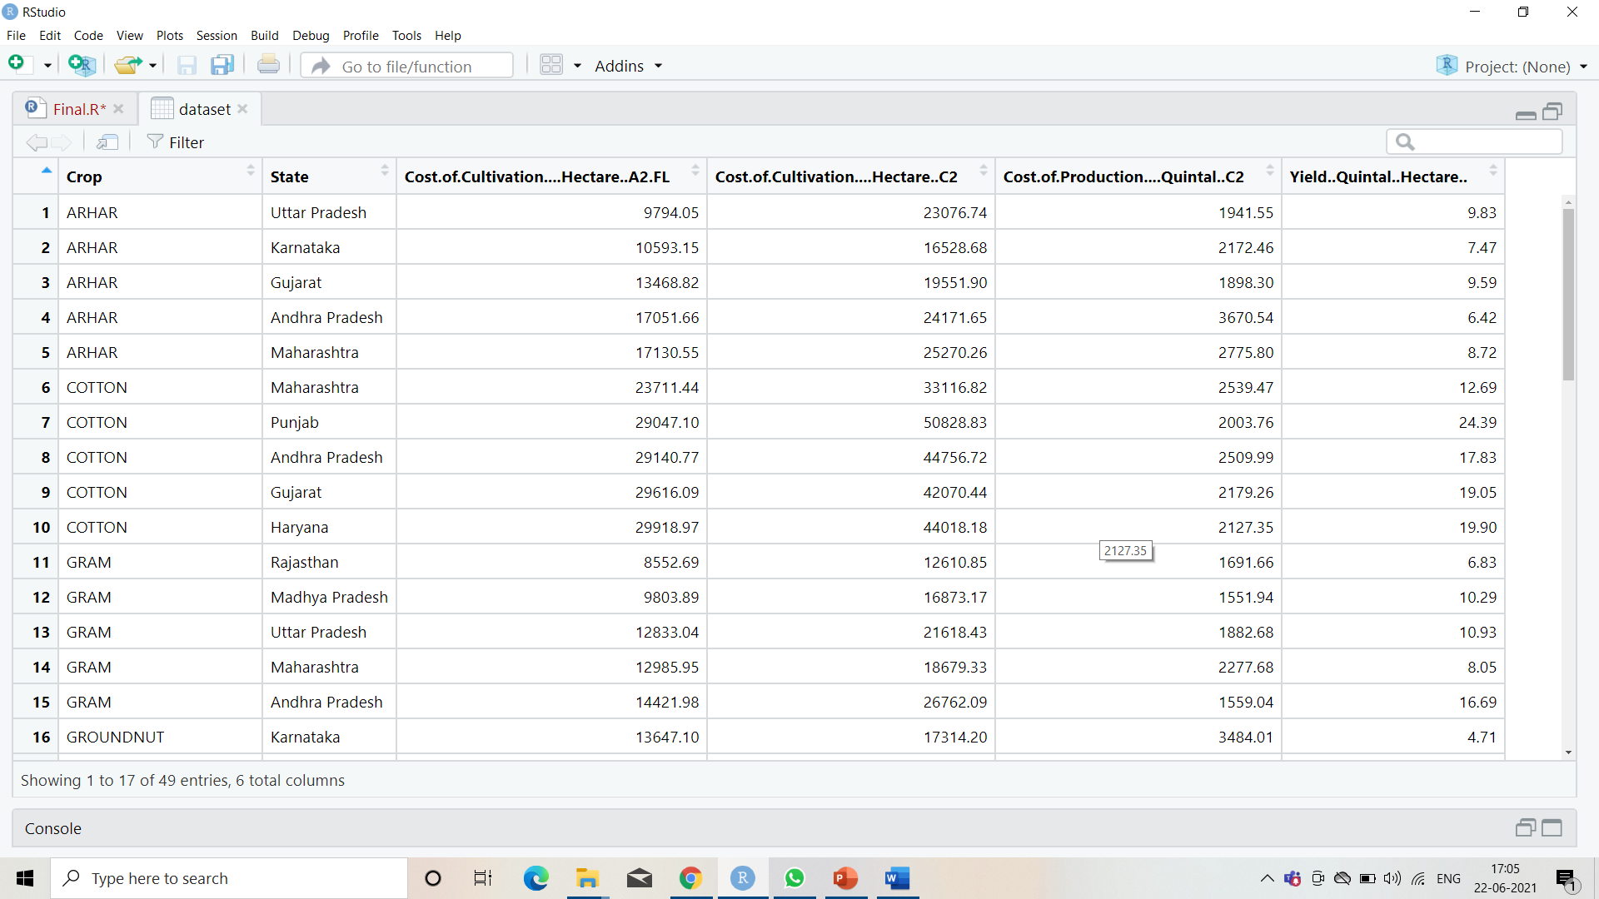

Slide 4
Description:
This Dataset is all about the crop yield, its production and cultivation variations in different States of India.
There are total 49 Observations(rows) and 6 Variables( columns) in this dataset.

Slide 5
Tasks
To Compare Crop Production in Different States of India using Bar graphs.
Comparing the Production in Quintal of Two States Gujarat and Andhra Pradesh Using Boxplot
Comparing The Cultivation of crops in Area 1 and Area 2.

Slide 6
Lets see the Code…

Slide 7

Presentation by: Sakshi Kakde

